Slide 1
Implementation of K Nearest Neighbors in Java
By Anthony Schroeder and tanner stoops

Slide 2


What is K Nearest Neighbors
K Nearest Neighbors is a non-parametric, instanced-based learning algorithm
Non-parametric meaning that instead of using a probability distribution derived from the data. It is compared directly against the training data
Instance-based learning, lazy learning, instead of creating an abstraction from the training data, it instead stores all the training data and compares the query to the data and classifies it according to its nearest neighbors

Slide 3

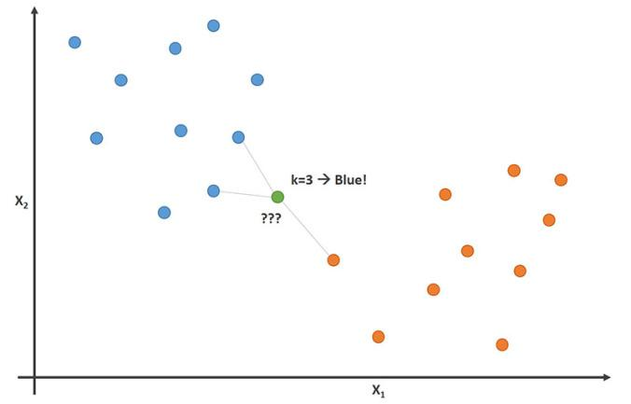
What is K Nearest Neighbors
K Nearest Neighbors is a simple algorithm where the test data is compared to all training data points by using one of the methods to find distance between it and the rest of the data, takes the K nearest data points and then classifies the test data according to whatever the majority that its nearest neighbors are.

Slide 4
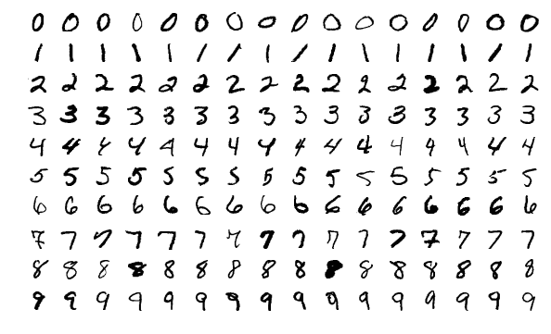
The Data Set
We are using MNIST data of handwritten digits, it contain a data set of 70,000 handwritten digits from 0-9. 60,000 of these used for training purposes while the remaining 10,000 are used to test the algorithm's accuracy.

Slide 5
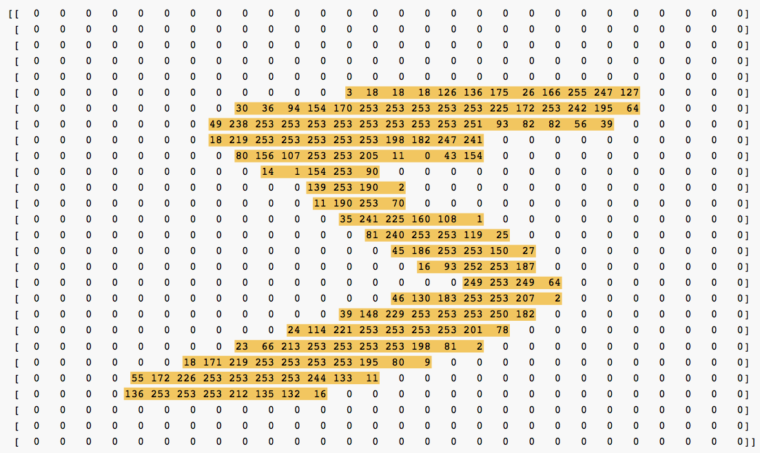
Mnist
Each of these images in the dataset are 28 by 28 and are gray scale. This means that each image can be thought of as a 28 by 28 matrix with each cell representing a pixel, the pixels’ values range from 0-255, with 0 being white and 255 being black. The benefit of the data being in gray scale is that only one matrix needs to be used. We treat the matrix as one long vector with 784 dimensions.

Slide 6
Mnist DataSet
Reading the data and changing it into a useable format was the first obstacle. The data is saved in as bytes, and unlike python there isn’t a plethora of mnist readers, so we had to make our own. The information for the images has the first 16 bits reserved for the magic number, the number of images, the number of rows of each image, and the number of columns of each image with each taking up 4 bits each. The rest of the information is saved as unsigned bits with each pixel taking a bit.

Slide 7
Mnist Dataset
First, we used the readAllBytes provided by the java.nio.file.Files library to import all the bytes to a byte array.
Second, we had to convert 32 bits into integers by using bitwise operators for example the magic number
int magicNumber= (b[0]<<24)&0xff000000|
(b[1]<<16)&0x00ff0000|
(b[2]<< 8)&0x0000ff00|
(b[3]<< 0)&0x000000ff;
Each bit is shifted to the left and then and operation is performed to join them

Slide 8
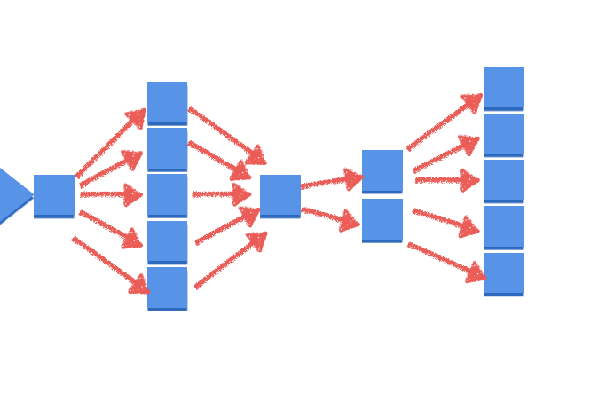

Parallelization
To calculate the distance, we chose the normalized Euclidean function $dist\left(A,B\right)=\sqrt{\frac{\sum_{i=1}^{m}{(x_{i}−y_{i}})^{2}}{m}}$. Most of the time of the program is spent on calculating the distances between each of the 10,000 test points and the 60,000 training points resulting in 600,000 calculations. The reading of the mnist files and inputting them into arrays only took around 300 nanoseconds compared to the distance calculations that took around 15 minutes. To deal with this we decided to thread the distance calculations and the predictions.

Slide 9
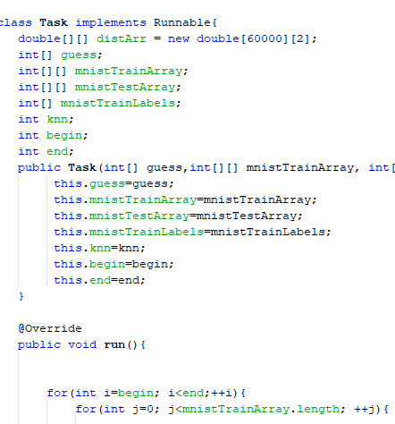
Threading In Java
Threading in C++ was much easier to do than threading in Java. In C++ you just have to pass it a function with the correct parameters while in Java your class must either implement Runnable or extends Thread. We decided to go with implementing runnable for the reasons showed in the following slide. Threading dropped the time from around 13-15 minutes down to 3-4 minutes.

Slide 10
Extending Thread Vs Implement Runnable
The most important reason to choose implement runnable is because it allows you to extend another class
The second is that it encapsulates the code that runs in parallel allowing you pass that instance to any other thread
You don’t import all the other methods that come with the thread class
Lastly, you usually don’t want to add or change the features of the threads which is the main point of extending thread

Slide 11

One of the Issues We encountered between threading in Java and In C++
C++ allows us to pass by reference or by pointers making it easy to share objects between threads. Java only passes by value which makes it hard to share data between threads. To get around this there are three ways the first is to make the variable public in the class, the second is using an object then the value that java passes is the memory address of the object, and the last is through the static variables. We made use of the second one by sharing the arrays.

Slide 12
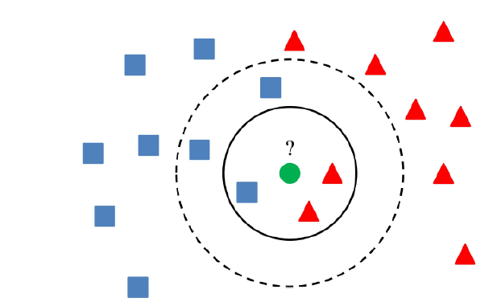
How to Choose K
There is no set way to find K so we will first set K to the square root of n, where n is the number of training data entries:
Large values for K can take a long time computationally, and if it is too large then everything is the most probable class
Small values for K, noisy values can have a large effect

Slide 13
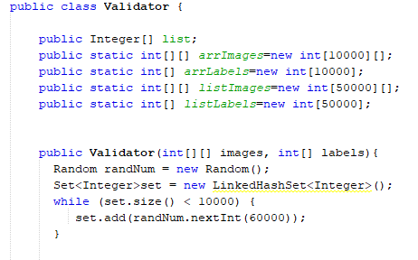
How we chose K
To prevent the overfitting of K by just guessing K and running the program over and over again. We made a Validator class to find the optimal K. The class takes the 60,000 training data images and splits off 10,000 of the images to compare the remaining 50,000 images against. We did this ten times and found the best value for k was 3. Implementing this efficiently was a struggle until I found out about sets, sets in java don’t allow duplicate elements, so I could add random numbers to it until I had 10,000 unique numbers between 0 and 59,999 inclusive to prevent bias when splitting the images.

Slide 14
Pros/Cons of K Nearest Neighbors
Pros
No assumptions are made about the data
Simple, its is easy to explain and understand
High Accuracy-it excels in classification
Classifier can updated easily as new instances with known classes are added
Cons
Since each testing data point is compared to all the training data points it can be computationally expensive
It can sensitive to noisy data, outliers
Sensitive to very unbalanced datasets

Slide 15

Success
The highest performance of KNN is around 97%. We reached 97% in accuracy vs the test images and consistently had 97-98 percent on the validation tests

Slide 16
In the Future
Try the cosine formula for the distance, it might be more accurate and it should be faster because we can take out an inner for loop
Try normalizing the vectors before using the distance formula
Use the bytebuffer function or the input buffer stream with it and test the difference

